Slide 1


Introgame
Sinh viên thực hiện :
- Nguyễn Mã Phi Long
- Trịnh Quang Tin
Giáo viên hướng dẫn :
THS. Trần Đình Sơn
Friday, 07/06/2019

Slide 2
Overview
Development in the future
Brief introduction of ideas
Upcoming features will be further developed in the website
Content
start
INTROGAME
Part One
Part Two
Part Three
WEBSITE LAYOUT
Introducing the layout of the website

Slide 3
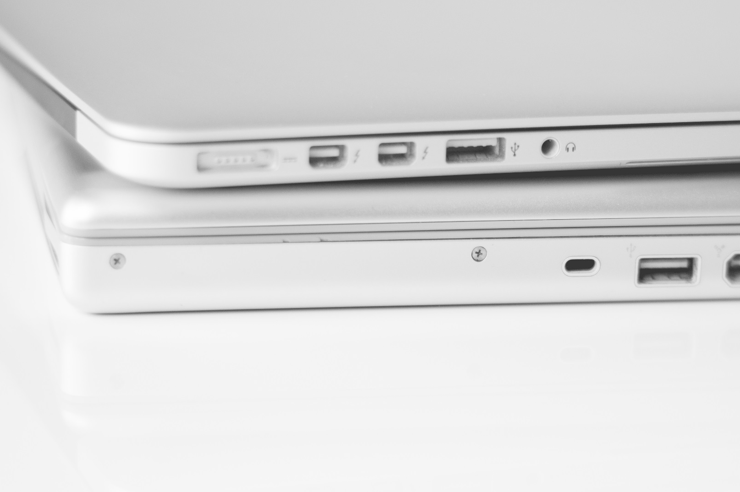
In the period of technology 4.0 with the rapid development of technology, the needs such as updating information, playing games, watching news, ... These are all demands that are no longer difficult for all people. Therefore, to meet these demands, INTROGAME is one of the websites that combines news and introduction of game products.
Overview - Introduce
INTROGAME

Slide 4





Good side of gaming
IntroGame
Help develop creative skills and solve problems.
Inspire learn history - geography.
Help make friends.
Develop communication skills.

Slide 5

Website Layout
IntroGame

Slide 6
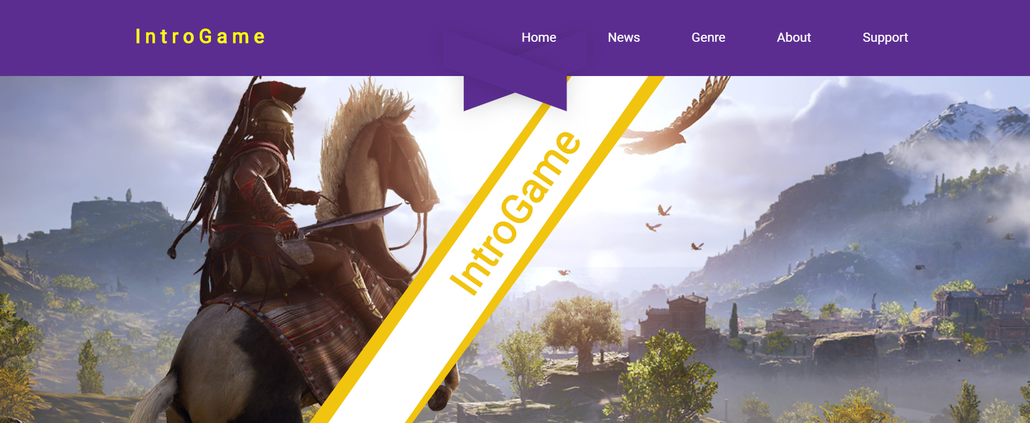
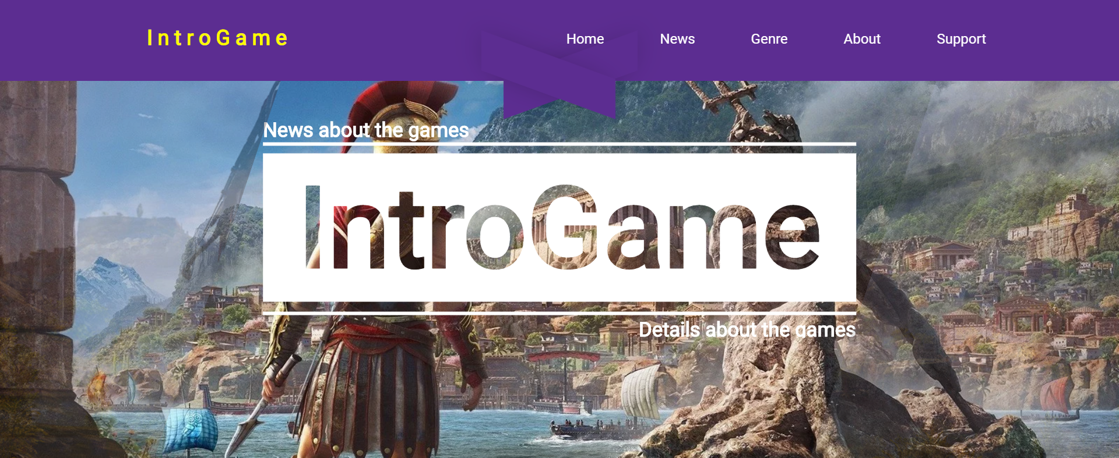
Layout of the website
The top
* Composition:
- Menu
+ Home
+ News
+ Genre
+ About
+ Support
- Banner
Hover

Slide 7
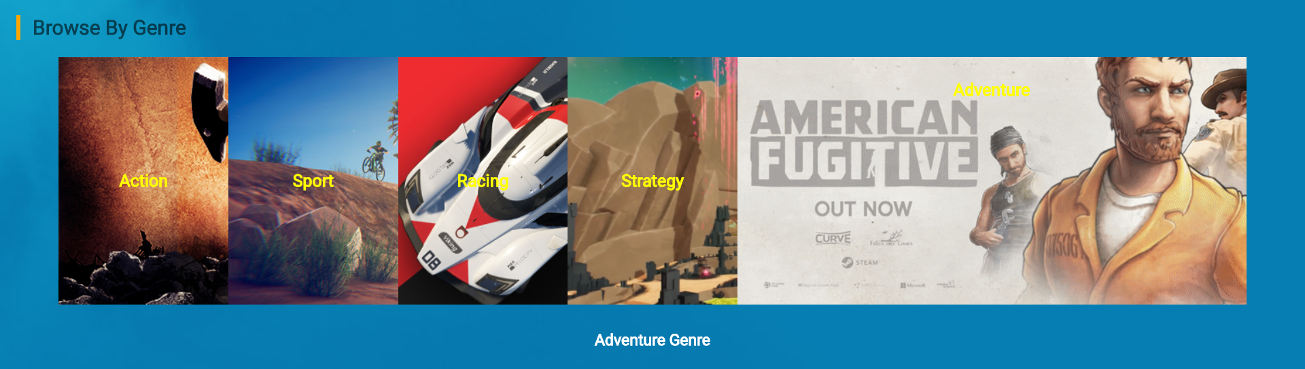
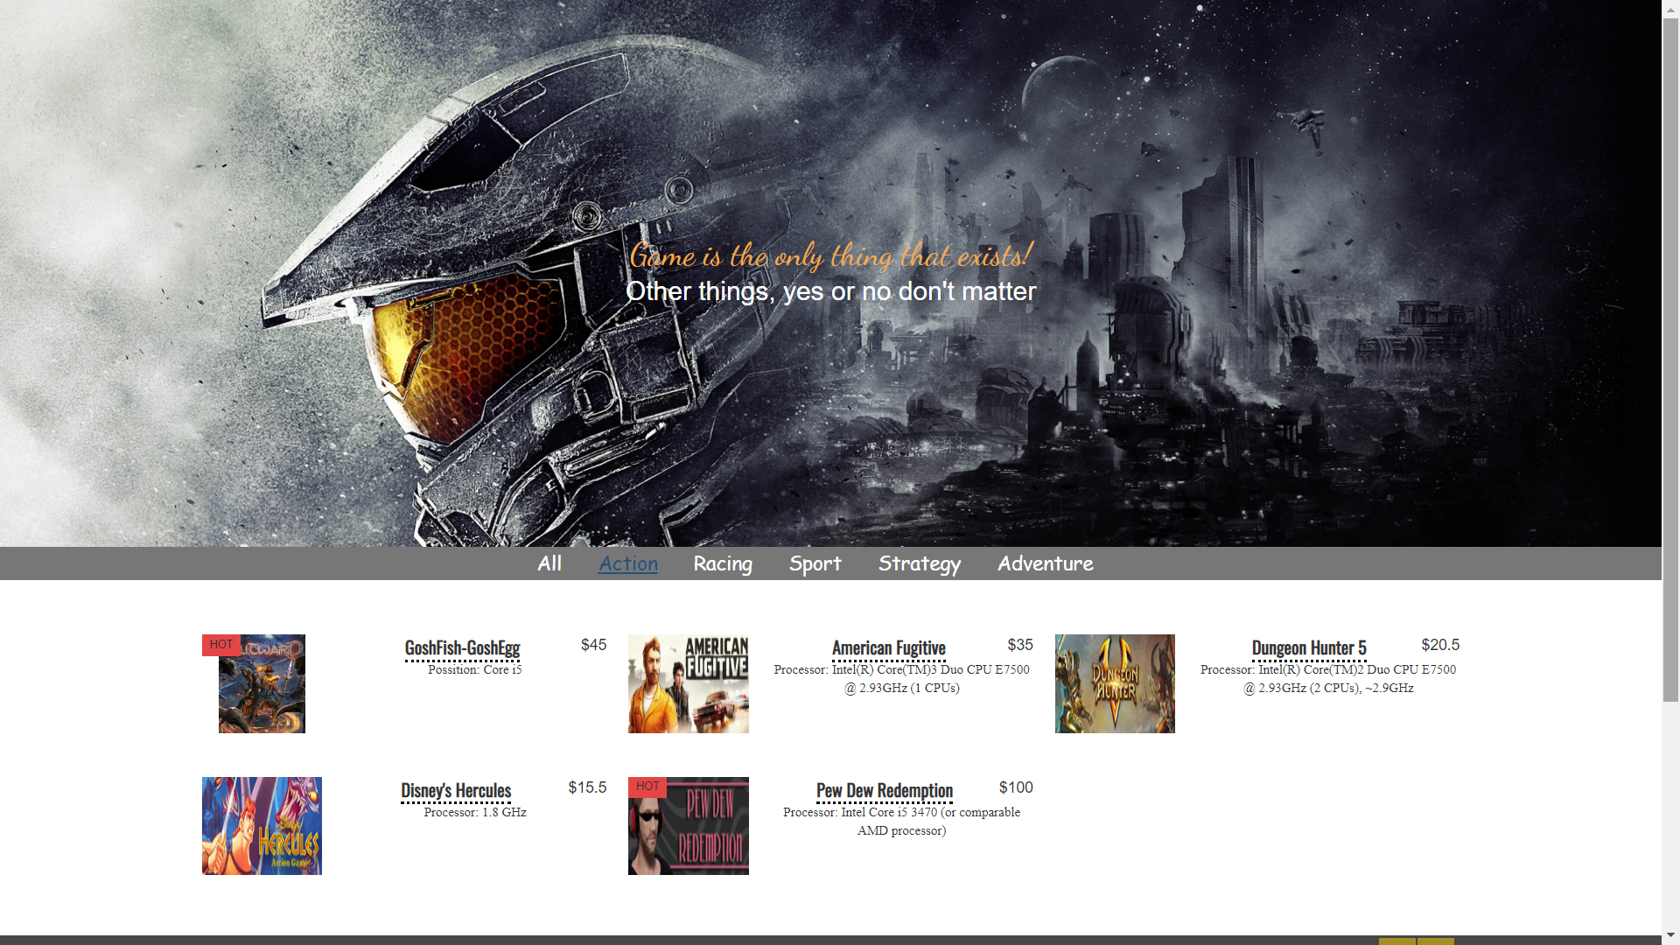
Layout of the website
The top – Genre
At this part, when clicking on the category, the user will enter a new page that can search for games according to each category them want:
Action
Sport
Racing
Strategy
Adventure

Slide 8
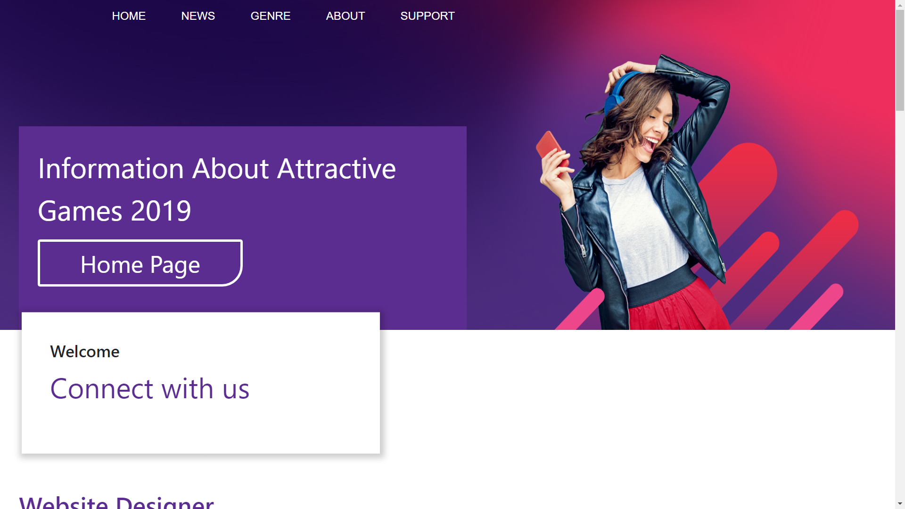
Layout of the website
The top – About
This section will introduce the designer, the website's goal, the game genres, contact us.

Slide 9

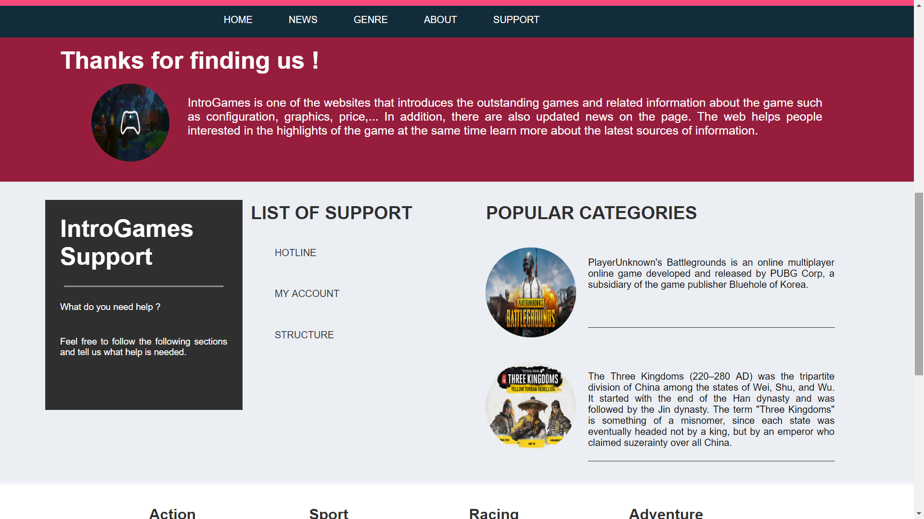
Layout of the website
The top – Support
Support customers when having problems and difficulties in accessing the website.

Slide 10
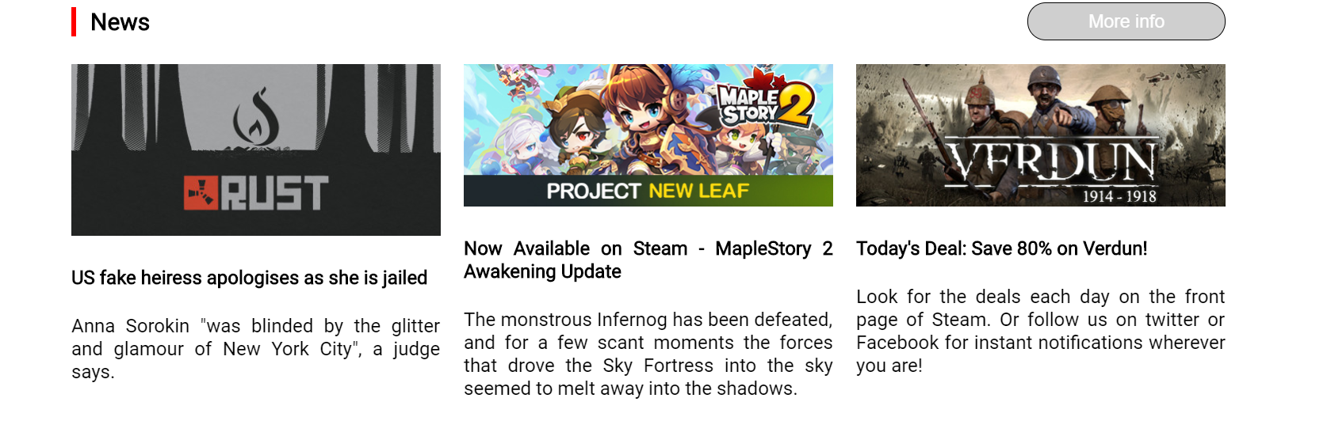
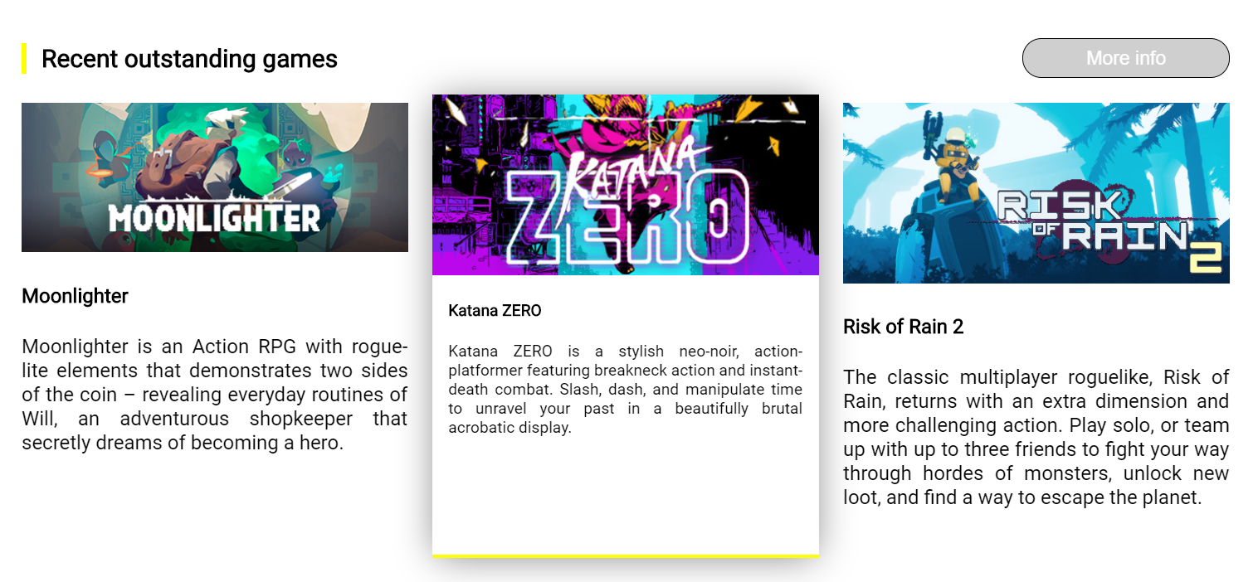
Layout of the website
The body
* Composition:
News
Recent outstanding games
Intro news game
Editor Pick
Browse by genre

Slide 11

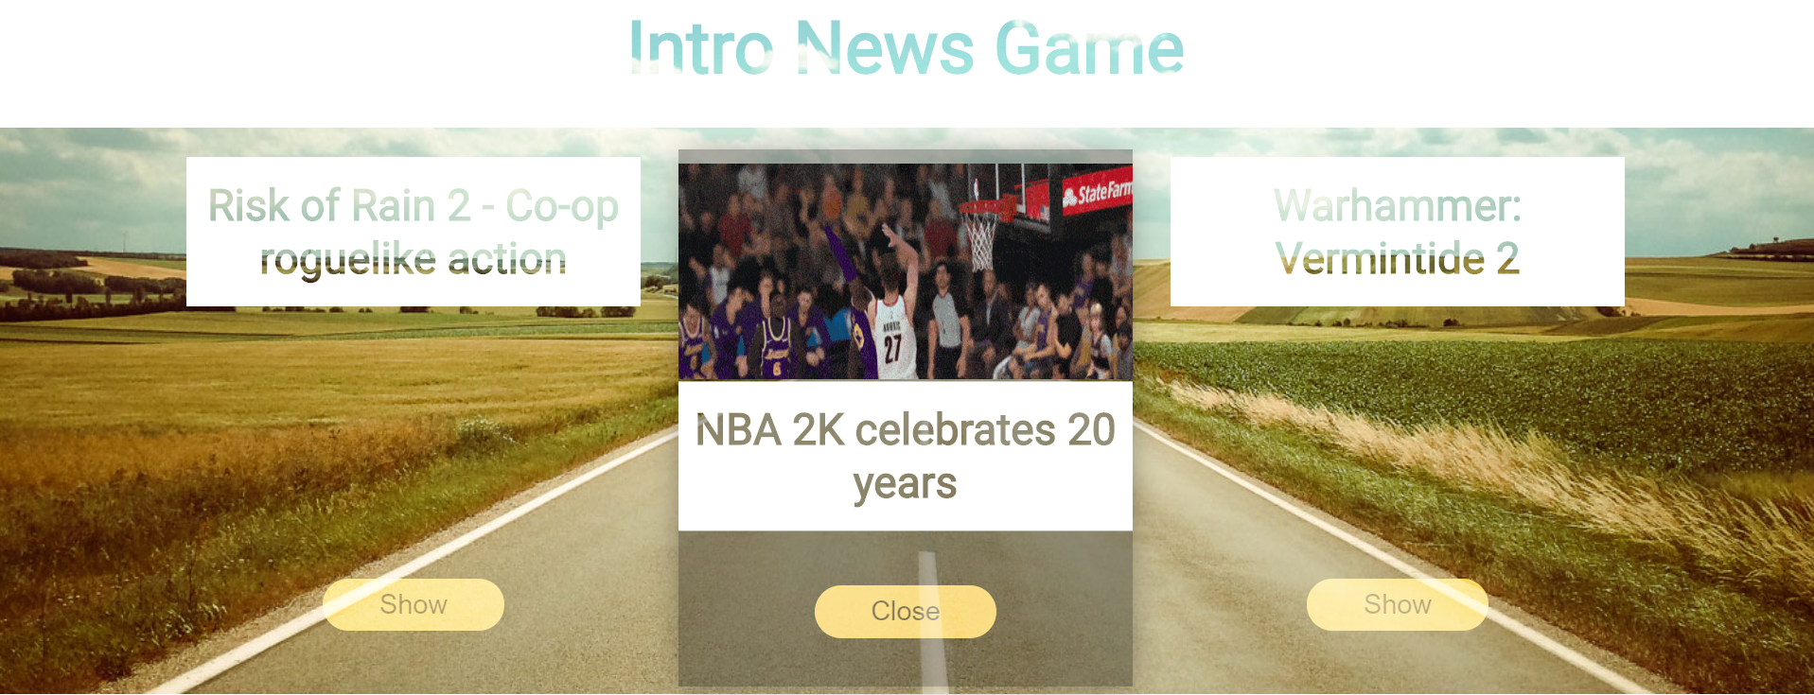
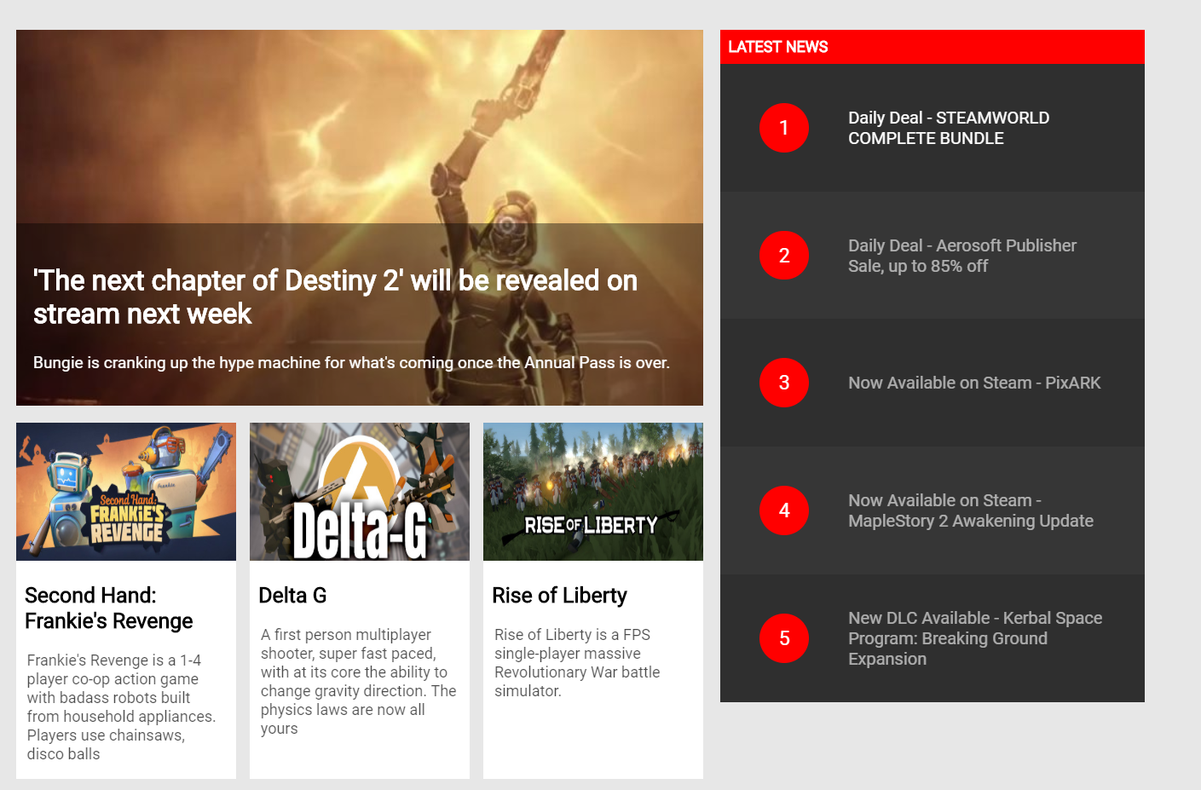
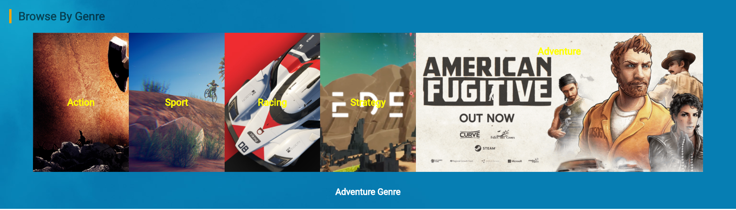
Intro news game
Editor Pick
Browse by genre
BOdy

Slide 12

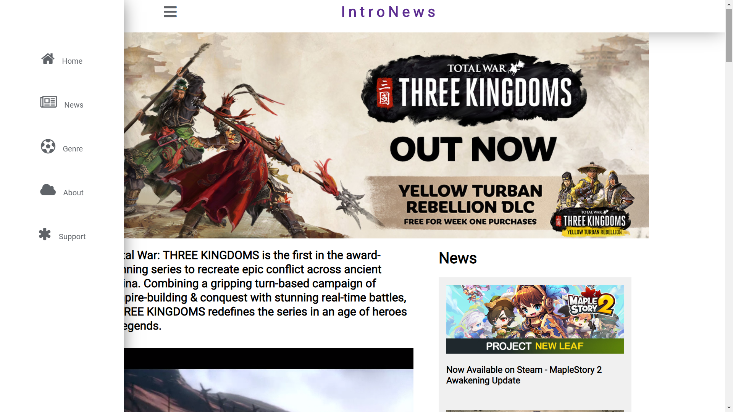
Layout of the website
The body - Product details
When users want to see detailed information about any product, there will be a website responsible for giving specific information and video review and advertising on the website right away.

Slide 13
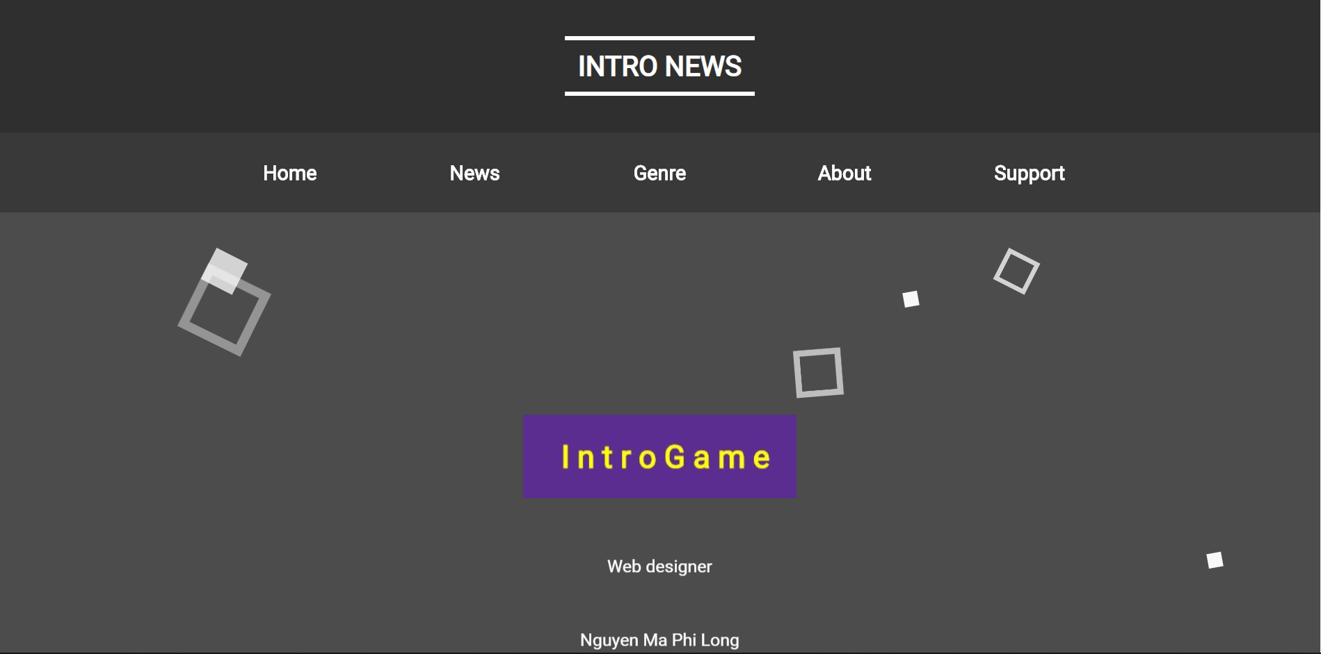
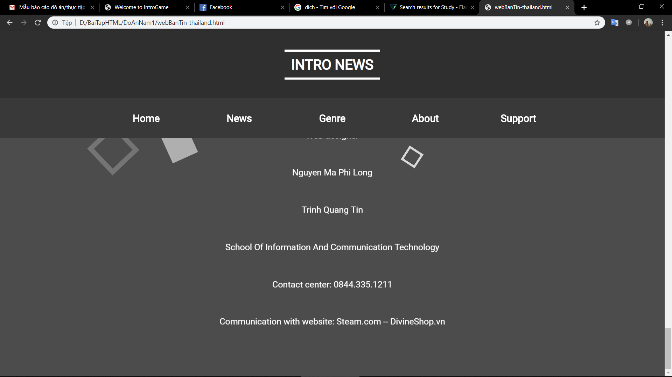
Layout of the website
The bottom
Includes contact information, website designer, and address

Slide 14




LanGuaGe
BUILDING WEBSITE
hTML
css
javascript

Slide 15
Development in the future
01
Expand the features of the website from promoting Game to trading Game.
02
Login Form
03
Comment, comment, chat directly with the administrator.
04
Can be used on multiple devices.

Slide 16

End
2016
THANK YOU FOR LISTENING

